Slide 1
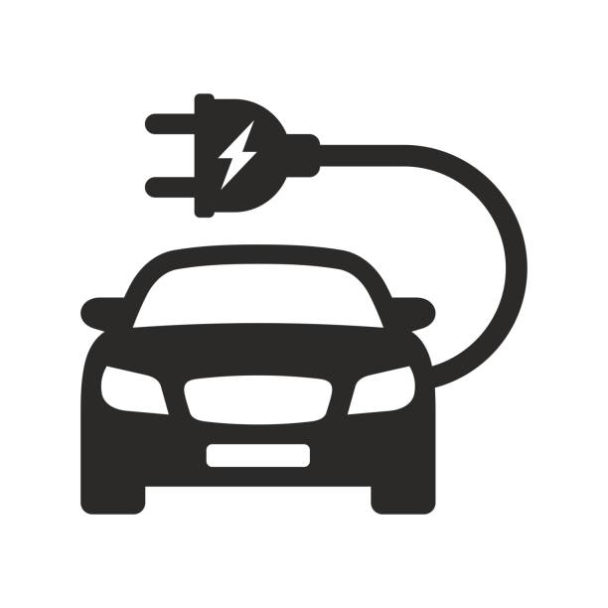


EV market study India for AtliQ
Made by Ishan Dutta

Slide 2
Problem Statement
AtliQ Motors, a leading automotive company from the USA known for its electric vehicles (EVs), has seen its market share in the North American electric and hybrid vehicle segment grow to 25% over the past five years. As part of their expansion strategy, the company is planning to introduce its best-selling models to the Indian market, where their current market share is below 2%. Bruce Haryali, the head of AtliQ Motors India, decided to conduct a comprehensive market study of the existing EV and hybrid vehicle market in India before moving forward with the launch.

Slide 3
Brief about the Data used
Three datasets were provided by the company EV sales by state, maker and dim dates. The rest of the tables used for analysis were created using the existing tables. In order to analyze the infrastructure and environmental aspects, another table was imported that contains columns like road length, density, EV charging stations, Humidity, AQI etc. to assess which states would be more suitable for launching our Electric Vehicle brand.

Slide 4
Overview about the dashboards
State Wise analysis: This dashboard analyses various metrics like EV and Non EV sales on a state wise basis, EV sales projection etc. and can be analyzed by Vehicle category and Month.
Maker Wise analysis: This dashboard analyses top and bottom makers by EV sales, CAGR, market share etc. It gives overview of total vehicles sold and total makers in the market for a competitor analysis.
EV Trend analysis: This dashboard analyses EV sales trend over time by state name and vehicle category slicers. Months with lowest and highest sales are displayed for better analysis.
EV infrastructure/environmental analysis: This dashboard gives an overview of the weather, environmental and infrastructure factors by state. One can get an idea of electricity generation, most polluted states, number of EV stations by state etc.
Revenue Analysis: This dashboard is for viewing total revenue and number of EV sold by state, year and vehicle category, and revenue growth rate .

Slide 5
Preliminary Research Insights
For 2023 for two wheelers: Top- Ola, Okinawa ,Hero electric
Bottom- Jitendra, Being, Pure EV
For 2024 for two wheelers: Top- Ola, TVS ,Ather
Bottom- Kinetic Green, Battre, Revolt
Highest Penetration rate for two wheelers are in Maharashtra, Delhi, Goa, Karnataka and Kerala while for four wheelers its in Chandigarh, Delhi, Goa, Karnataka, Kerala.
TVS has EV sales that grew gradually with each quarter while Ampere didn’t make much progress overall from Q1 to Q4. On the other hand, Hero Electric and Okinawa have seen sales with occasional peaks. Okinawa sales went down while Hero Electric saw a general rise in the fourth Quarter when compared to the first. Ola Electric performed the best although it saw a sharp fall in the Q2.
In 2024, the EV sales for Delhi was 18134 and Karnataka was 20666 while penetration rates were almost the same.
The top 5 makers with highest CAGR were Jitendra, BYD, Bajaj, TVS and Tata Motors.
The top 10 states with non EV CAGR were West Bengal, Punjab, Chattisgarh, Gujarat, Assam, Maharashtra, Uttar Pradesh, Goa and Bihar.
Months of November, December, January, February and March see the highest EV sales while June,July, August,September and October have the lowest average EV sales.
States with negative penetration rate growth from 2022 to 2024: Delhi, Goa, Ladakh, Odisha, Uttarakhand, Andaman and Nicobar Island, Puducherry and Maharashtra .

Slide 6
Projection analysis
The revenue growth for 2022 vs 2024 would slightly decrease by 0.5% and for 2023 vs 2024 would be slightly less by 0.6%. Overall The decrease in revenue is negligible but still the reasons should be investigated.
Let us discuss the top 10 states by penetration rate and their projected sales in 2030.
The EV sales which are projected for 2030 would be the highest in Maharashtra around 22 lakhs, second highest would be in Chattisgarh with 7 lakhs and third highest would be in West Bengal with 5 lakh sales. The lowest sales would be in Tamil Nadu with almost 17500 EV sold. Goa, Karnataka and Odisha would have dismal sales between the range of 45000 to 50000 EVs sold in the state. Kerala and Delhi will have better sales of around 1.5 lakh and 1.1 lakh respectively. Rajasthan might touch 1 lakh EVs sold in their state.

Slide 7
Secondary Research Insights
Cost Savings/Environment/Incentives: We can say its likely a mix of cost savings (fuel efficiency), environmental concerns, and government incentives are driving 4-wheeler EV adoption in 2023-2024 Incentives
Boost Adoption: Incentives can significantly increase adoption rates for both 2-wheelers and 4-wheelers. States like Telangana, Gujarat, and Maharashtra offer high subsidies for Evs.
Charging Stations & Sales: More charging stations correlate with higher EV sales and penetration. Top 5 states with high charging infrastructure may also have higher EV sales Brand Ambassador: Right now in India we should collaborate with Olympics and paralympics winners as they have gained a surge in popularity and they are young as well which would get a young audience to the company.
Ideal Manufacturing State: We can look for states with high EV subsidies, business-friendly policies, and stable governance (e.g., Gujarat, Maharashtra)

Slide 8
Recommendations to AtliQ
After considering the Infrastructural and Environmental analysis I can give recommendations which are:
First of all, EV should be launched in states where there are high pollution, more charging stations and good road infrastructure like Delhi, Chandigarh etc. This suggests that they have good purchasing power and literacy level.
Second would be to tie up with government agencies to spread awareness about EV and also to get subsidies which would be beneficial in the long run.
Finally to keep in mind that India is a price sensitive country where people are mostly lower-middle income segment.The pricing must be kept affordable and value for money should be positioned to the buyer.

Slide 9
Acknowledgments
First and foremost, I would like to extend my gratitude to Codebasics for organizing this competition. It closely mirrors real-world scenarios, providing invaluable opportunities to tackle practical challenges. In this context, the true achievement lies not in winning or losing, but in the learning gained through participation.
Additionally, I would like to thank Vahanseva for generously offering a comprehensive dataset, which has been instrumental in the development of this project.
Finally, I appreciate your time and attention in reviewing this report.

